Slide 1
Wine quality
Analysis of what makes a “good” wine
Mingjun Li, Yifei Zhou, Allen Martinez

Slide 2
Analysis of what makes a “good” wine
Background and Purpose
Data overview
Model Development
Conclusion

Slide 3
Background and Purpose
Conversion of grapes to wine is an art
The core elements: good grapes of good quality, diligent wine making practices and barrel aging.
Comes down to chemical compounds and composition
Provide insight for maintaining and improving quality
Our goal is to identify which of these many variables have a significant effect on wine quality.

Slide 4
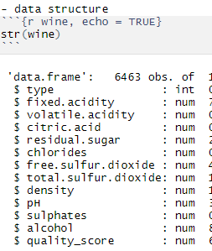
The Data
Variables:
Type
Fixed Acidity
Volatile Acidity
Citric Acid
Residual Sugar
Chlorides
Free Sulfur Dioxide
Total Sulfur Dioxide
Density
pH
Sulphates
Alcohol
Quality Score
Notes:
1 - fixed acidity: most acids involved with wine or fixed or nonvolatile (do not evaporate readily)
2 - volatile acidity: the amount of acetic acid in wine, which at too high of levels can lead to an unpleasant, vinegar taste
3 - citric acid: found in small quantities, citric acid can add ‘freshness’ and flavor to wines
4 - residual sugar: the amount of sugar remaining after fermentation stops, it’s rare to find wines with less than 1 gram/liter and wines with greater than 45 grams/liter are considered sweet
5 - chlorides: the amount of salt in the wine
6 - free sulfur dioxide: the free form of SO2SO2 exists in equilibrium between molecular SO2SO2 (as a dissolved gas) and bisulfite ion; it prevents microbial growth and the oxidation of wine
7 - total sulfur dioxide: amount of free and bound forms of S02S02; in low concentrations, SO2SO2 is mostly undetectable in wine, but at free SO2SO2 concentrations over 50 ppm, SO2SO2 becomes evident in the nose and taste of wine
8 - density: the density of water is close to that of water depending on the percent alcohol and sugar content
9 - pH: describes how acidic or basic a wine is on a scale from 0 (very acidic) to 14 (very basic); most wines are between 3-4 on the pH scale
10 - sulphates: a wine additive which can contribute to sulfur dioxide gas (S02S02) levels, wich acts as an antimicrobial and antioxidant
11 - alcohol: the percent alcohol content of the wine
Output variable (based on sensory data): 12 - quality (score between 0 and 10)

Slide 5
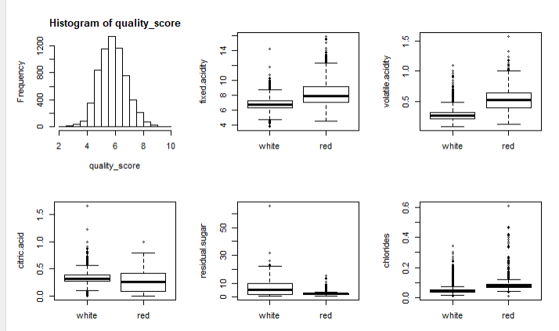
Model development
Data Distribution
Relationship with Quality Score
Regression Models
Diagnostic Plots
Variable selection
Stepwise (forward and backward)
Best subset
Reweight Model
Bootstrap

Slide 6
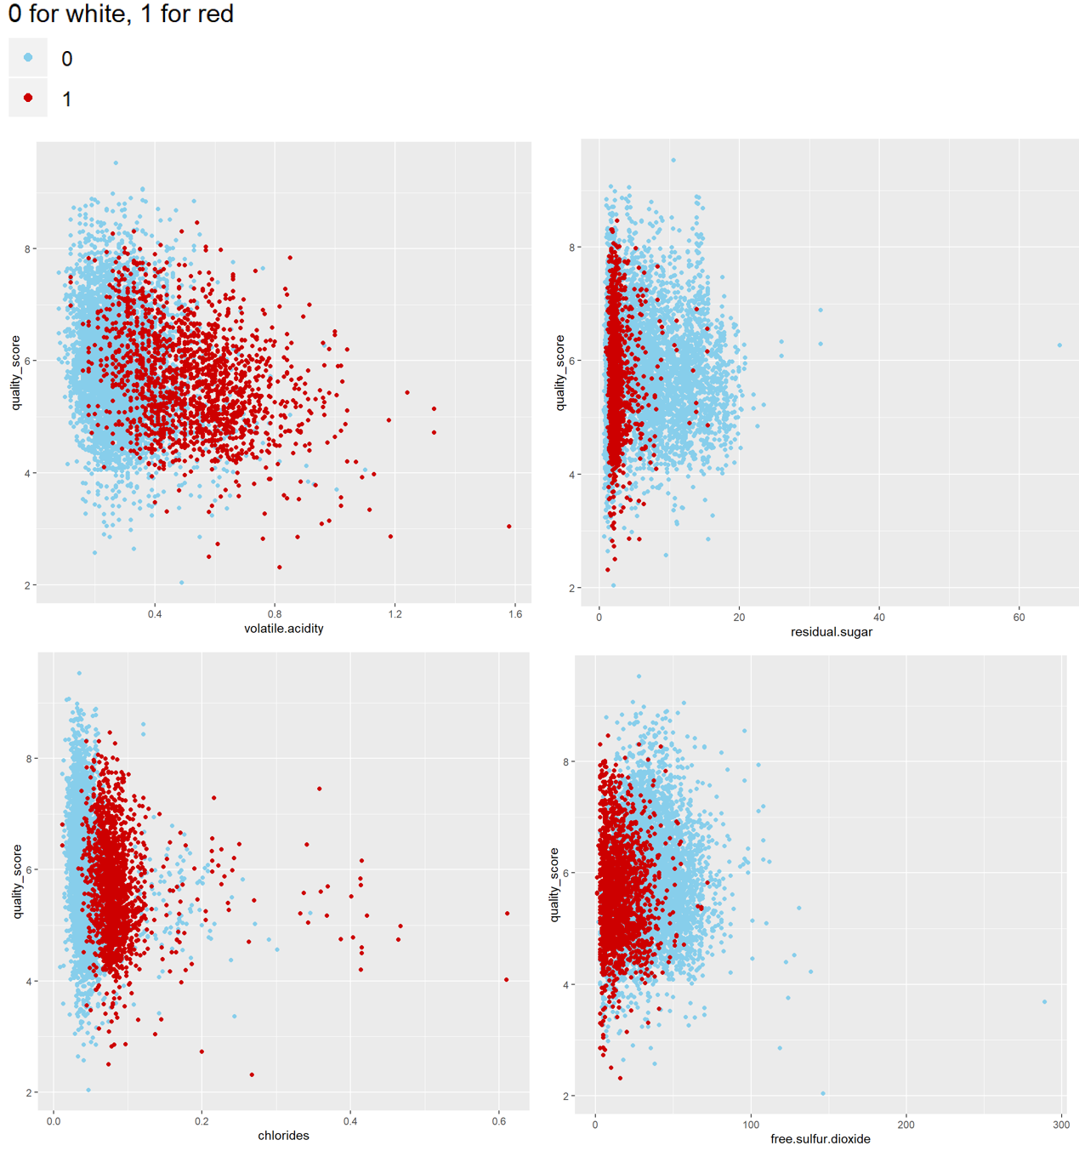
Model development
Data Distribution
Relationship with Quality Score
Regression Models
Diagnostic Plots
Variable selection
Stepwise (forward and backward)
Best subset
Reweight Model
Bootstrap

Slide 7
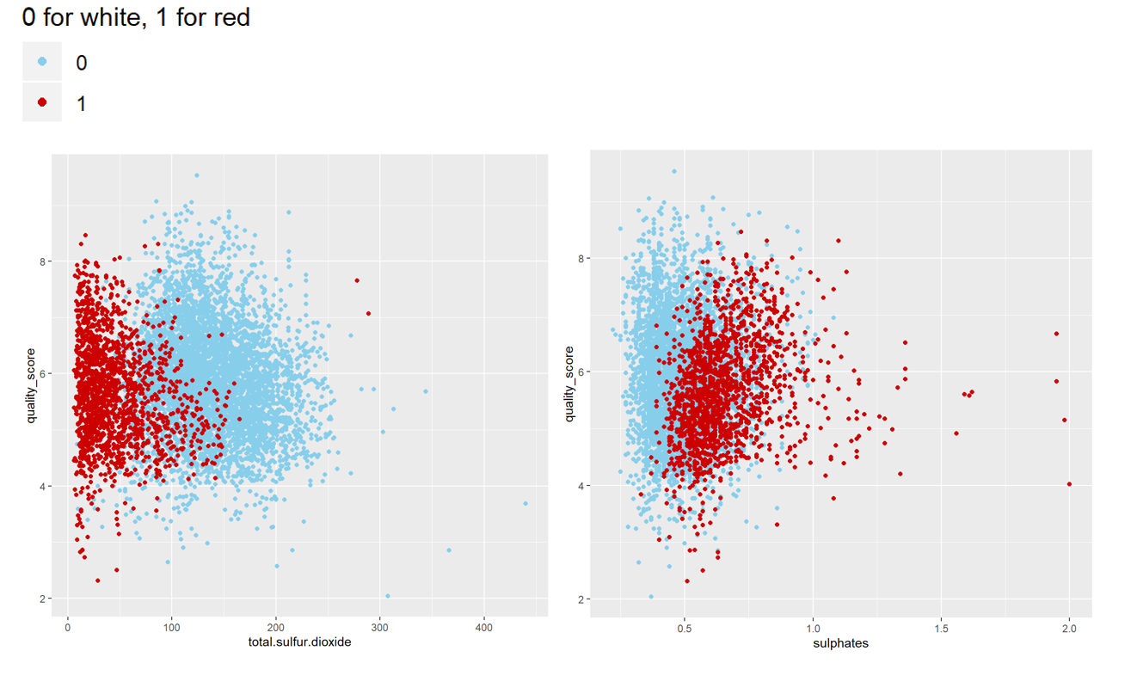
Model development
Data Distribution
Relationship with Quality Score
Regression Models
Diagnostic Plots
Variable selection
Stepwise (forward and backward)
Best subset
Reweight Model
Bootstrap

Slide 8
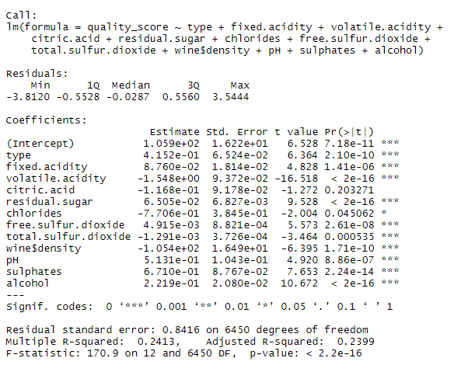
Model development
Data Distribution
Relationship with Quality Score
Regression Models
Diagnostic Plots
Variable selection
Stepwise (forward and backward)
Best subset
Reweight Model
Bootstrap

Slide 9
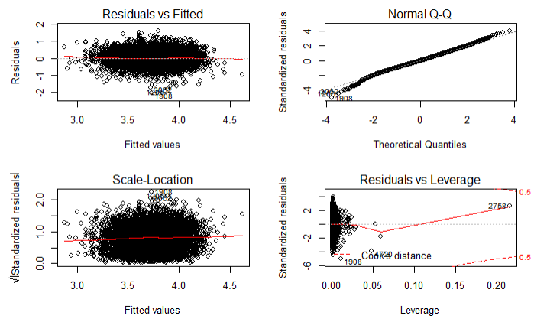
Model development
Data Distribution
Relationship with Quality Score
Regression Models
Diagnostic Plots
Variable selection
Stepwise (forward and backward)
Best subset
Reweight Model
Bootstrap

Slide 10
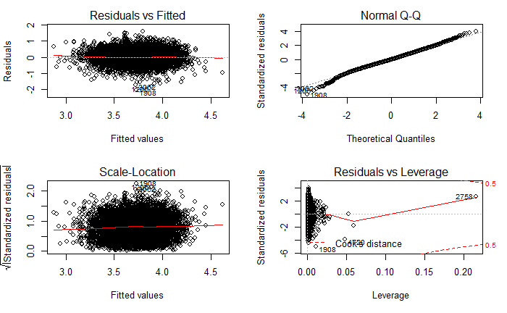
Model development
After transformation: y^.7475
Data Distribution
Relationship with Quality Score
Regression Models
Diagnostic Plots
Variable selection
Stepwise (forward and backward)
Best subset
Reweight Model
Bootstrap

Slide 11
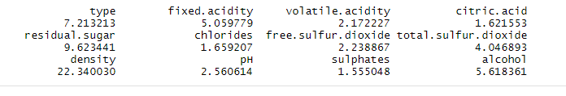
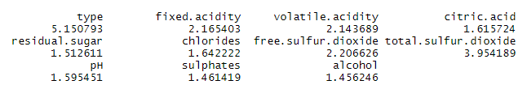
Model development
Data Distribution
Relationship with Quality Score
Regression Models
Diagnostic Plots
Variable selection
Stepwise (forward and backward)
Best subset
Reweight Model
Bootstrap

Slide 12
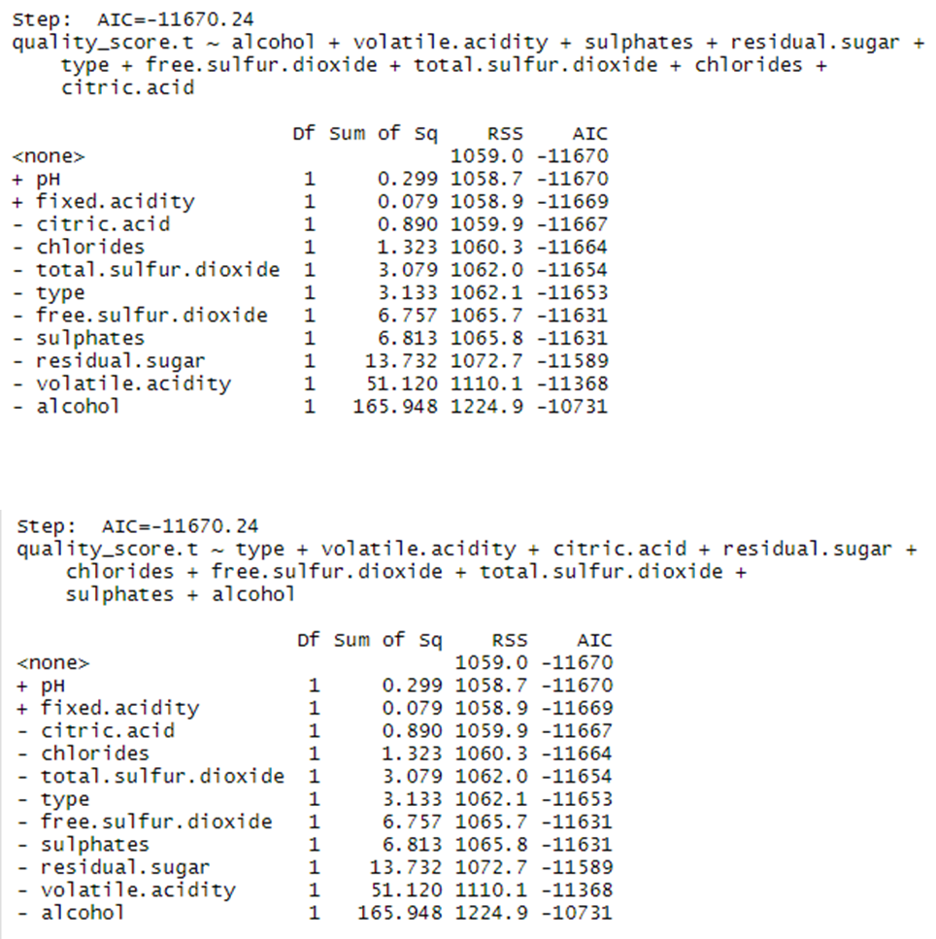
Model development
Data Distribution
Relationship with Quality Score
Regression Models
Diagnostic Plots
Variable selection
Stepwise (forward and backward)
Best subset
Reweight Model
Bootstrap

Slide 13
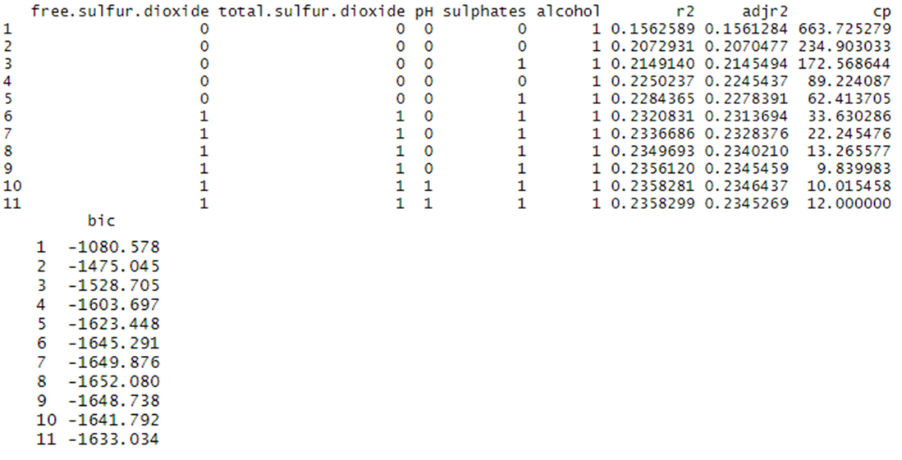
Model development
Data Distribution
Relationship with Quality Score
Regression Models
Diagnostic Plots
Variable selection
Stepwise (forward and backward)
Best subset
Reweight Model
Bootstrap

Slide 14
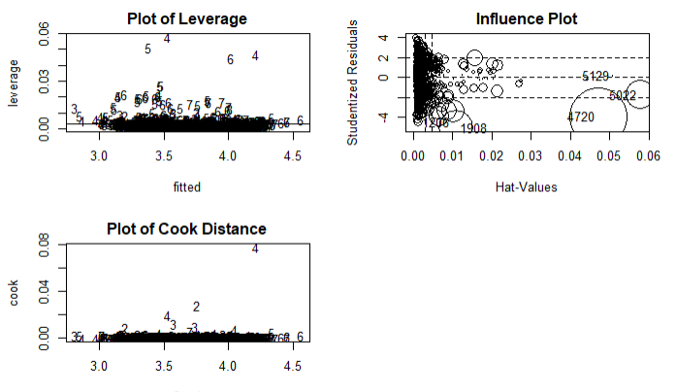
Model development
Data Distribution
Relationship with Quality Score
Regression Models
Diagnostic Plots
Variable selection
Stepwise (forward and backward)
Best subset
Reweight Model
Bootstrap

Slide 15
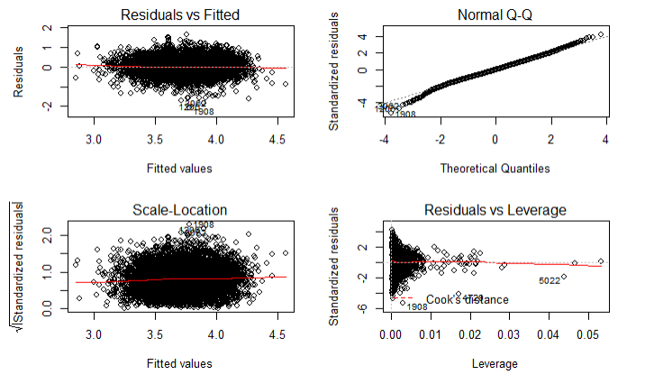
Model development
Data Distribution
Relationship with Quality Score
Regression Models
Diagnostic Plots
Variable selection
Stepwise (forward and backward)
Best subset
Reweight Model
Bootstrap

Slide 16
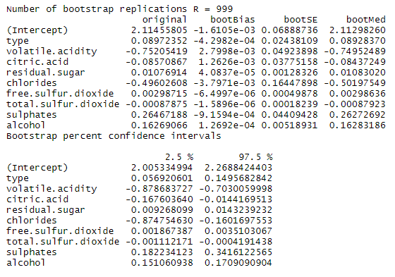
Model development
Data Distribution
Relationship with Quality Score
Regression Models
Diagnostic Plots
Variable selection
Stepwise (forward and backward)
Best subset
Reweight Model
Bootstrap

Slide 17
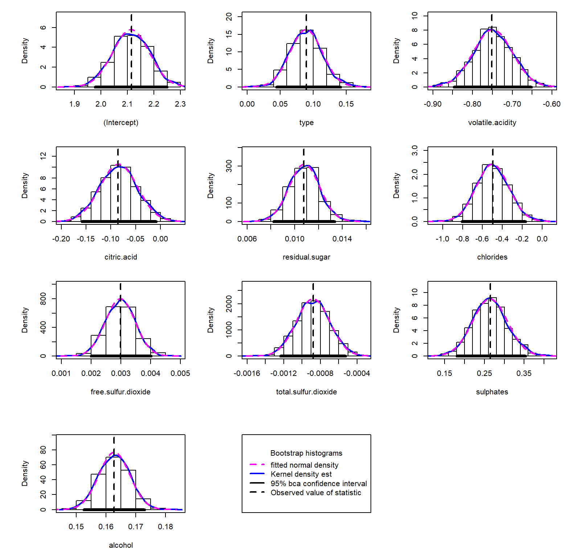
Model development
Data Distribution
Relationship with Quality Score
Regression Models
Diagnostic Plots
Variable selection
Stepwise (forward and backward)
Best subset
Reweight Model
Bootstrap

Slide 18
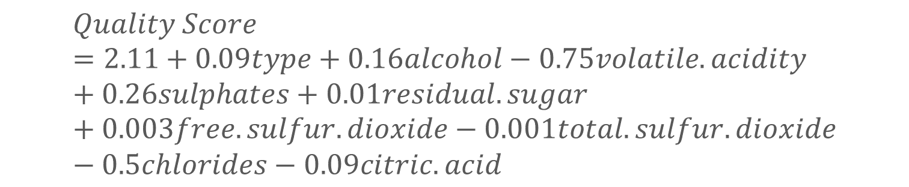
conclusion
Decrease the level of volatile.acidity and chlorides
Increase the level of sulphates
Improvement in wine quality and consistently produce “good” wine
$$Quality Score=2.11+0.09type+0.16alcohol−0.75volatile.acidity+0.26sulphates+0.01residual.sugar+0.003free.sulfur.dioxide−0.001total.sulfur.dioxide−0.5chlorides−0.09citric.acid$$

Slide 19
Questions?

